Slide 1
KLU Design Thinking for Innovation Project Title: Work In Progress Submission 2
Department :CSE
Rohini Pandiri

Slide 2
Project -Introduction
S.NO | ID.NO | Name | Role in the project
01 | 2100031934 | Rohini Pandiri | Mentor

Slide 3
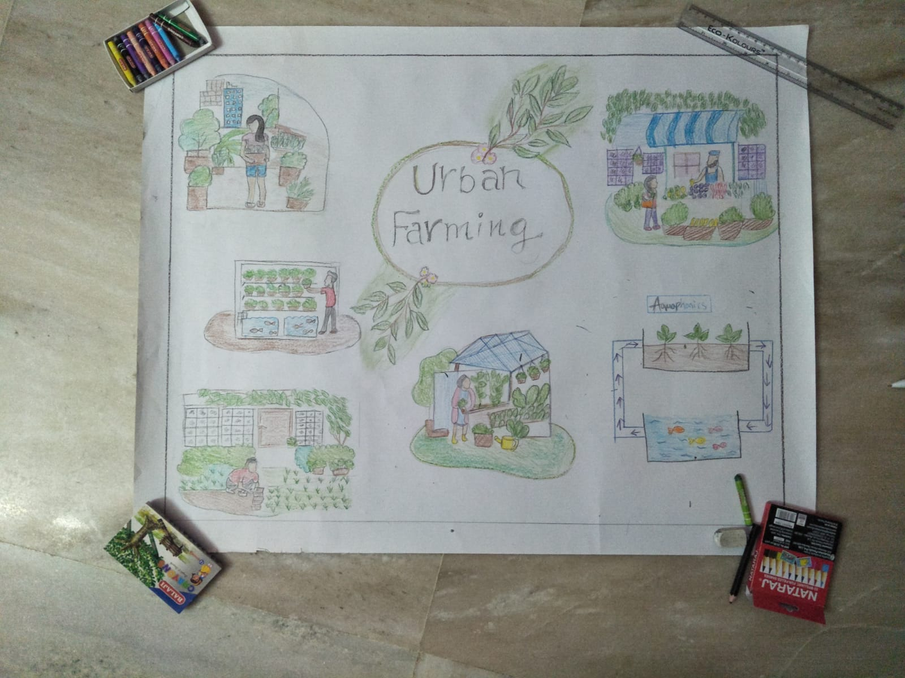
Rough Prototype:

Slide 4
Our Most Important Learnings :
Necessity of prototype is a chance to gather more accurate requirements and obtain market feedback.
Rough prototyping quickly mock-up the ideas using simple assets that are already available in the spot

Slide 5
Testing :
1)What works ?
the idea of urban farming works in urban areas.
2)What doesn't works ?
It works fine but the surrounding conditions around the urban farm plants like humidity and light varies from prototype to real model
3)What could Be improved?
smart water management

Slide 6
4)Things you like most?
implementing this idea helps in food and livelihood insecurity in urban areas
as it makes the fresh food available for nearby residencies people and less
transportation charges needed
5) Current scenario of urban farming ?
Scientists in West Bengal, had initial success on growing brinjal and tomato
hydroponically on a small scale. Punjab also has succeeded in producing potato
tubers through vertical farming
6) What was difficult or strange about this task, if anything?
Meeting the demand for more food of higher quality.

Slide 7
Learnings from Testing anD High fidelity prototype:
It is important to test the product before launching it in the market to foresee any issues or failures. Getting the most out of the feedback can be done with a prototype that is closest to the final product in its detail and functionality.

Slide 8
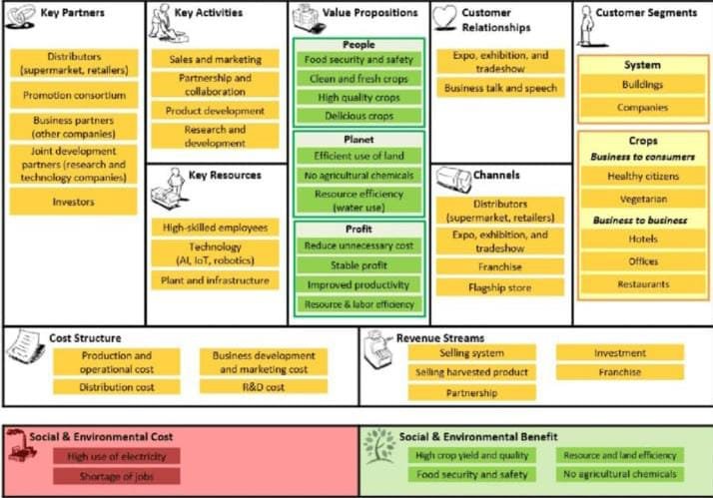
Business model canvas

Slide 9
Cost of Estimation :
Small vertical farms spend an average of $3.45 per square foot on energy while large vertical farms spend an average of $8.02 per square foot. Small farms are facilities smaller than 10,000 square feet, while large farms are anything bigger than that.
Indoor vertical farms typically spend 56% of their operating budget on labour, roughly $20per square feet.
Expenses for materials like growing media, seeds, and nutrient solution, typically accounting for 11% of a vertical farm’s budget I.e $5.

Slide 10
Things we Learned about Design Thinking:
Design thinking is a process for solving
problems by prioritizing the consumer's needs above
all else. It relies on observing, with empathy, how
people interact with their environments, and employs
an iterative, hands-on approach to creating innovative
solutions.

Slide 11
Things we Learned about applying Design Thinking in future
What will do differently in applying design thinking for projects that you will take up in upcoming years of degree and Profession?
Reduce stress throughout a project
Prevent repetitive issues
Achieve better results faster
You will have to test new ways to engage and motivate your teammates, and iterate as time goes on. But with benefits like increased efficiency and collaboration, design thinking is worth it.

Slide 12


